Slide 1
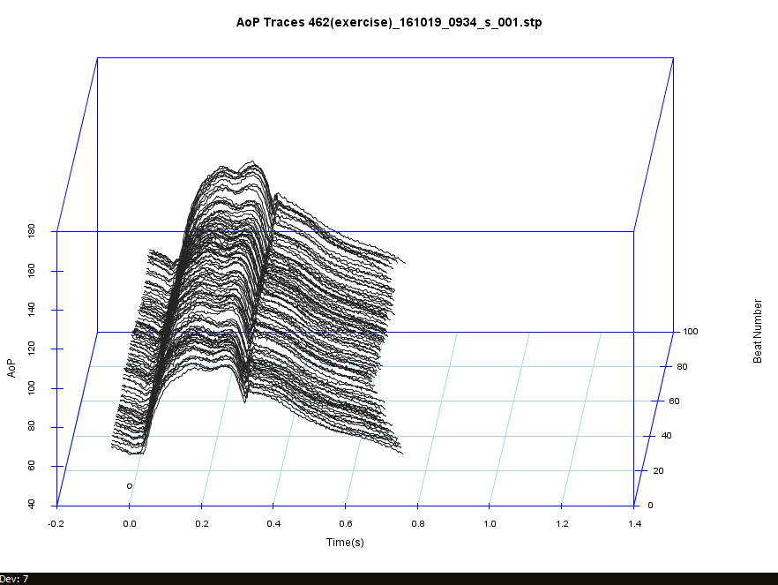
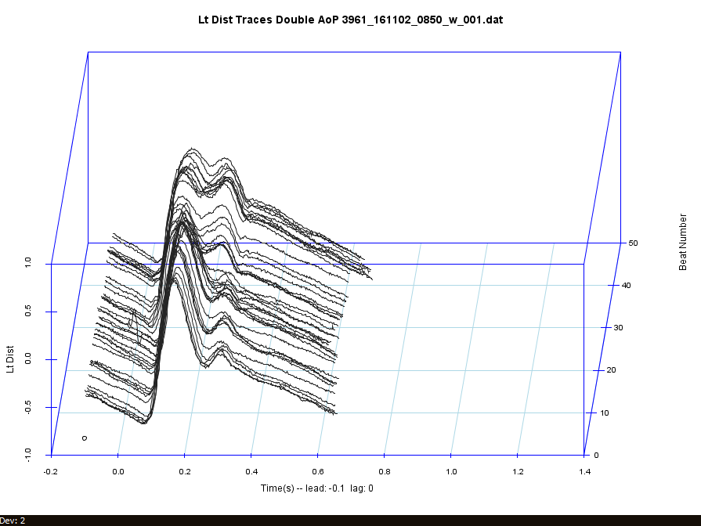
Notes:
Waterfall plots are also a novel way to demonstrate phenomena difficult to appreciate in standard time domain recording. For example the waterfall plot (left) illustrates 100 consecutive Aortic Pressure waveforms in a normal 35yo male showing late systolic peaking. This wave in late systole is a reflected wave from the peripheral vasculature and cannot be palpated during a physical exam. In contrast, the waterfall plot (right) demonstrates the change in the aortic pressure waveform as a catheter is passed from the brachial artery to the aorta in a young active duty patient with a cardiac condition associated with sudden death called hypertrophic cardiomyopathy. It shows an initial rapid rise and peaking of systolic pressure with a secondary pulse becomes apparent closer to the heart. This secondary pulse can palpated as a double pulsation in the carotid pulse, a finding known as a bifid pulse which has diagnostic significance.

Slide 2
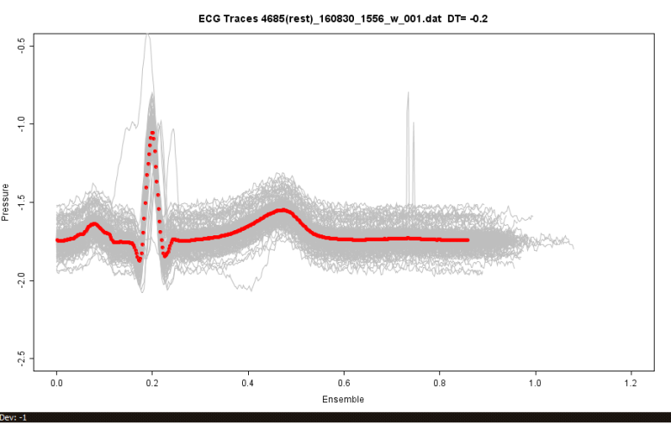
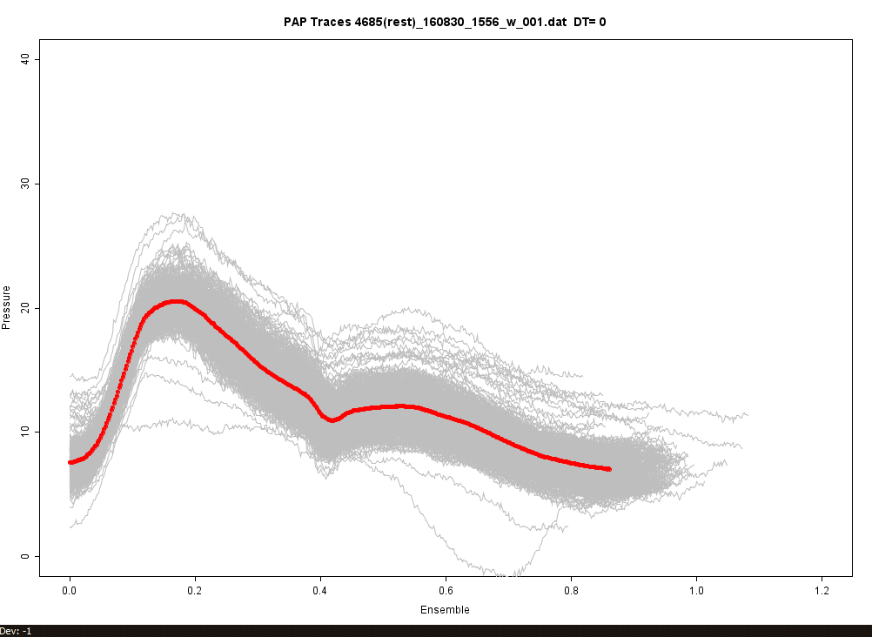
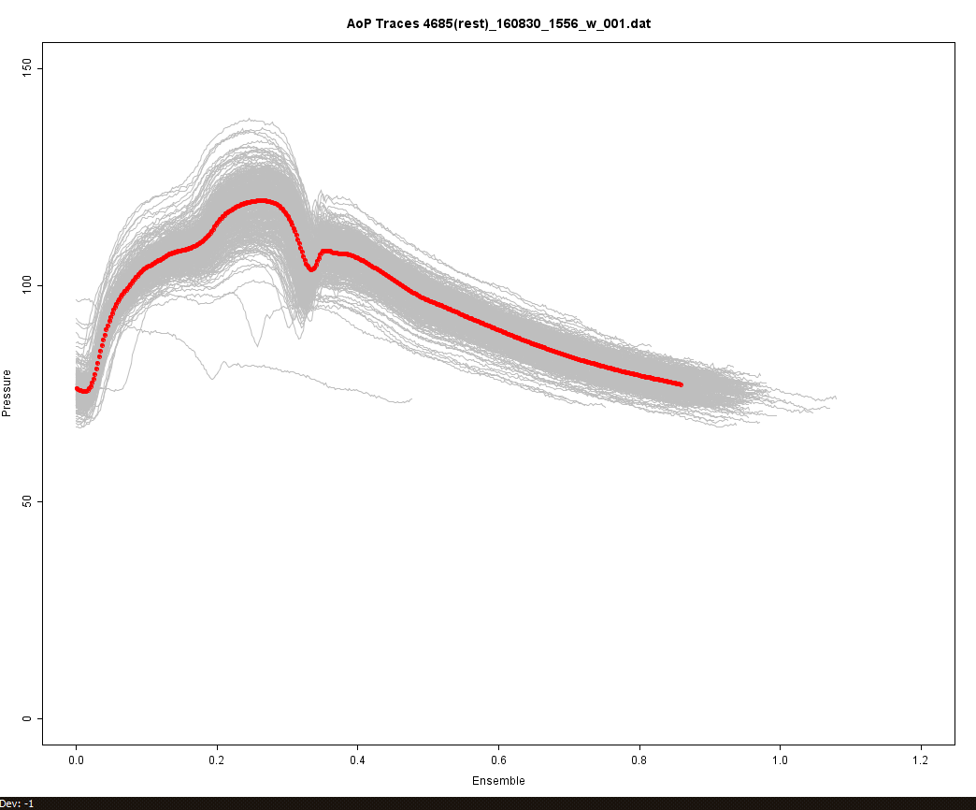
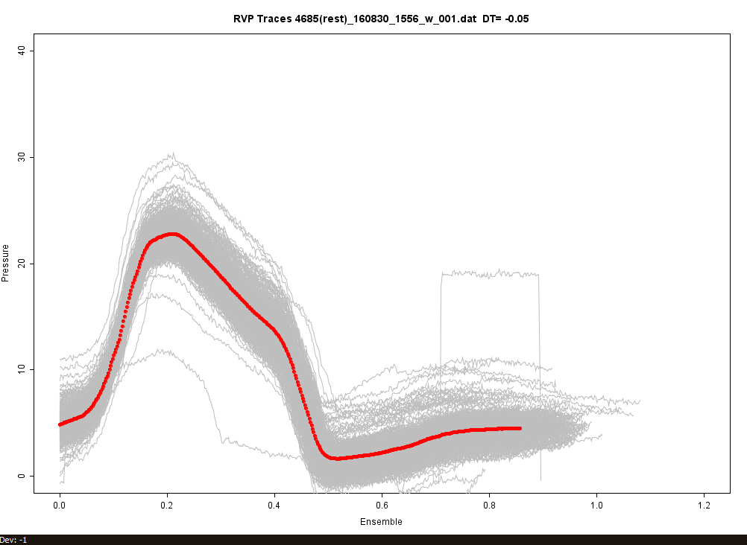
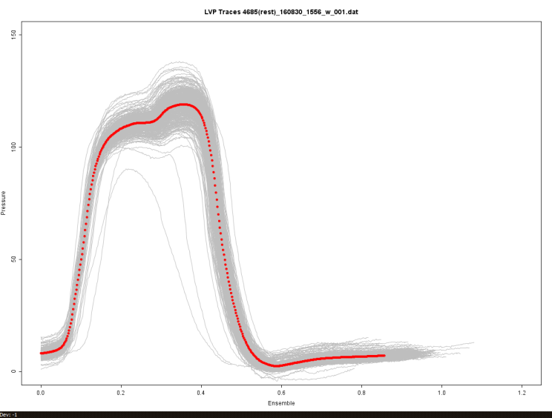
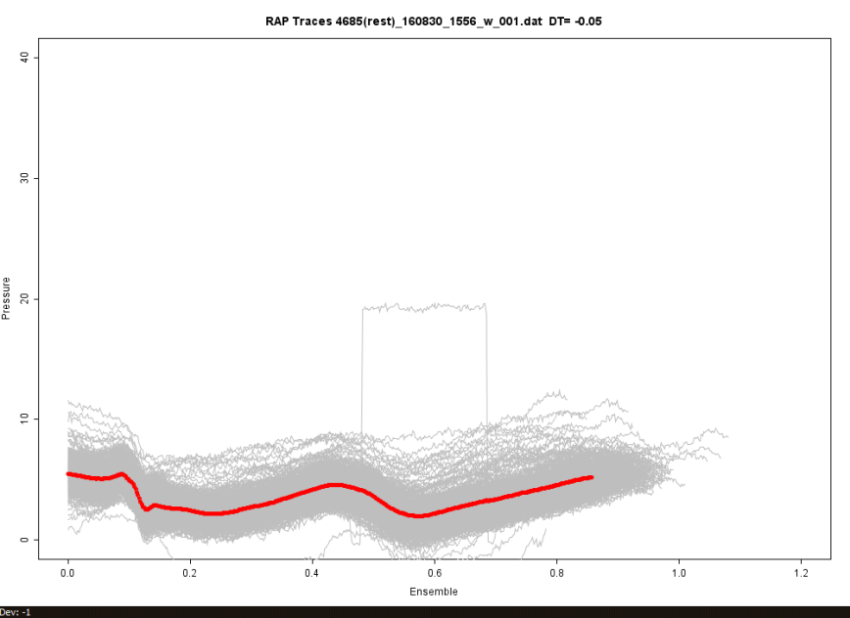
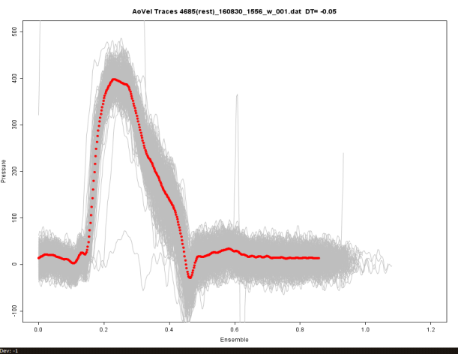
Notes:
Illustrates the value of ensemble averaging to depict waveforms representative entire recording period, reduces noise in periodic signals, illustrates respiratory variability in hemodynamic waveforms, and shows the incidences and significance of outliers.
Ensemble averaged waveforms provides measures that are not bias by snap shots views of data. Ensemble averaged images if recorded during steady state an be aligned with fiducial point and presented as Wiggers’ like diagram for ease of clinical interpretation.

Slide 3
Graphic demonstrating
Aligned fluid PA and PCWP waveforms if recorded in steady state

Slide 4
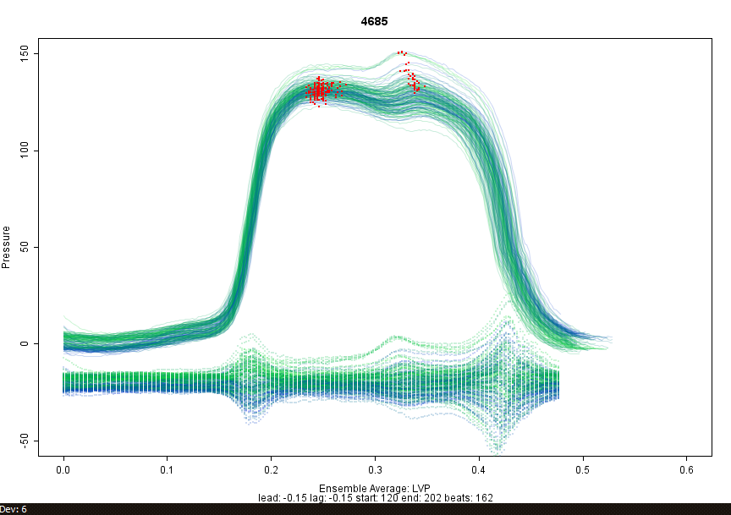
Notes:
Ensemble average of 162 consecutive cardiac cycles illustrating the physiological effect of respiration on the systolic pressure measurement in a normal subject whose secondary systolic waveforms dominates during expiratory phases of respiration.

Slide 5
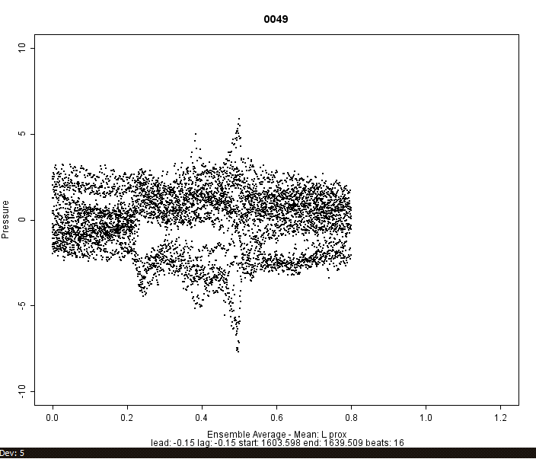
Notes:
Depict difference between ensemble averaged waveform and individual waveform. Notice the respiratory bias in this hemodynanmic measuremnt byt the more dense distribution of data toward expiratory phases of the respiratory cycle. These data suggest that there is bias of mean measurmements that depend on patients respiratory pattern.

Slide 6
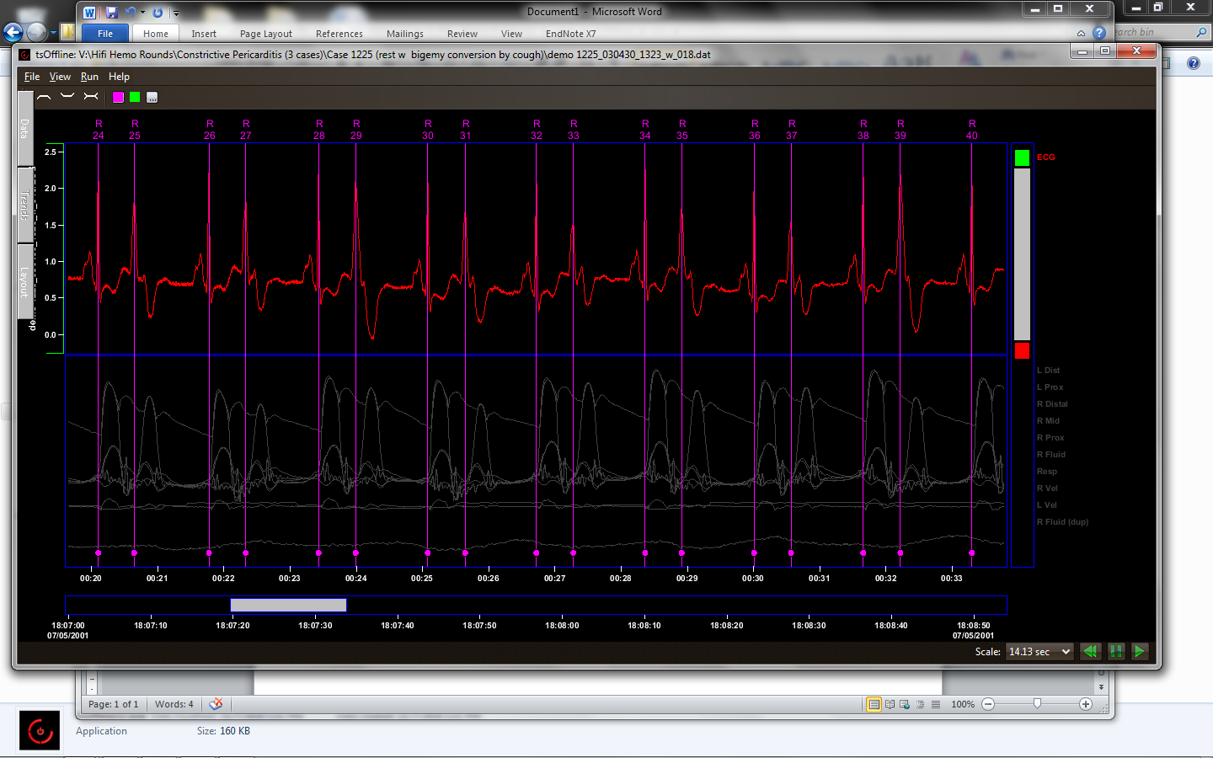
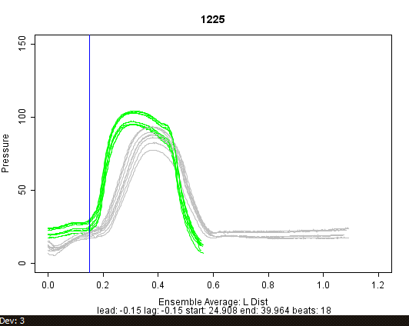
Notes:
Ensemble displays may also be use do demonstrate the effects of ventricular dyssynchrony as in this example of a patient with a bigeminal heart rhythm.

